Slide 1
INTERNSHIP STUDIO VIBHUTI PATIL Start of internship: 25 july 2021 ETHICAL HACKING

Slide 2
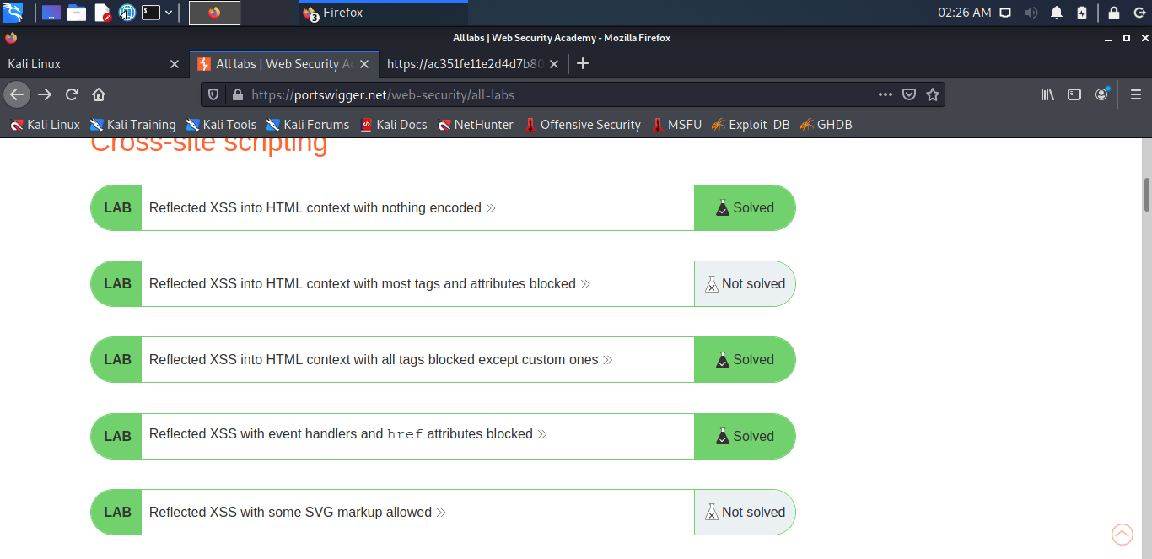
Task 1 :
Through https://portwigger.net/ I have solved 5 XSS labs :
Screenshots are given below:

Slide 3
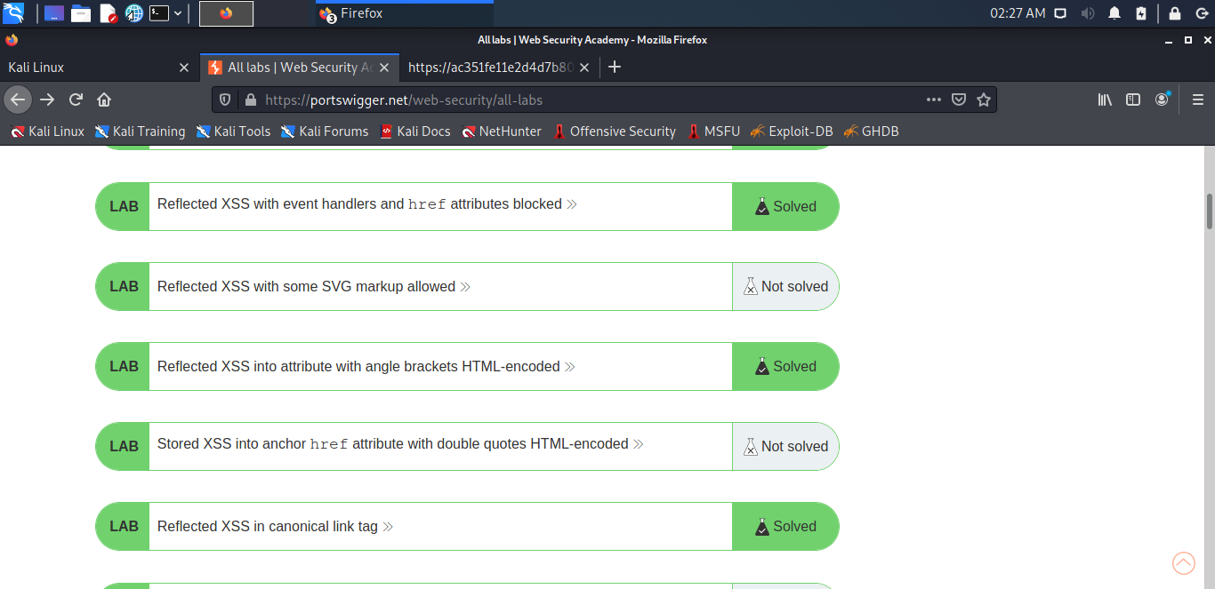
Task 1 : continue

Slide 4
For the next tasks ,
Kindly consider that I couldn’t download NETSPARKER , ACUNETIX , NGINX , NESSUS , so I just used kali linux , with the help of uniscan, also with some references online which I found related to that website , I have done the following tasks . So my report is not that detailed as it would with the help of above websites . So , it’s a kindly request that you judge me considering these things .
Thankyou

